Slide 1


CISC360 Computer Architecture
Lesson 14
Parallel Processors

Slide 2
Multiple Processor Organization
AKA, Flynn’s Taxonomy
Single instruction, single data stream - SISD
Single instruction, multiple data stream - SIMD
Multiple instruction, single data stream - MISD
Multiple instruction, multiple data stream- MIMD

Slide 3
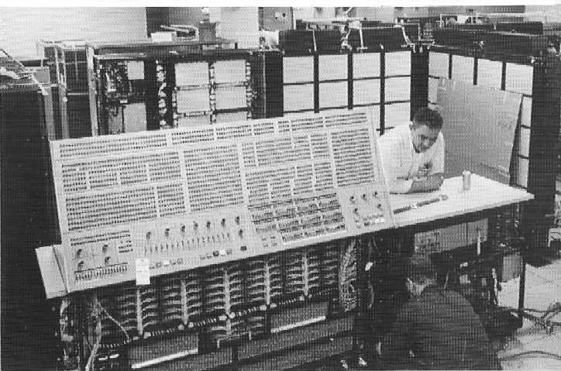
Single Instruction, Single Data Stream - SISD
Single processor
Single instruction stream
Data stored in single memory
Uni-processor
IBM 360/91

Slide 4
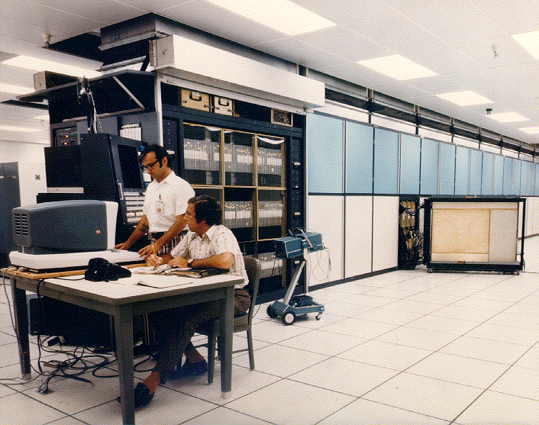
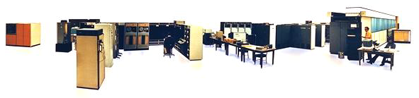
Single Instruction, Multiple Data Stream - SIMD
Single machine instruction
Controls simultaneous execution
Number of processing elements
Lockstep basis
Each processing element has associated data memory
Each instruction executed on different set of data by different processors
Vector and array processors
ILLIAC IV
64-way SIMD

Slide 5
Multiple Instruction, Single Data Stream - MISD
Sequence of data
Transmitted to set of processors
Each processor executes different instruction sequence
Never been implemented
???

Slide 6
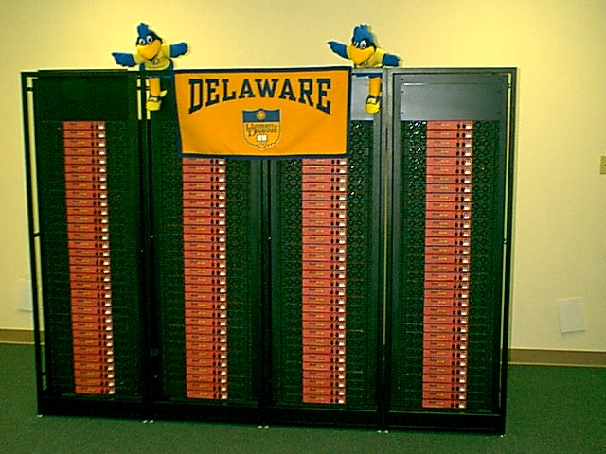
Multiple Instruction, Multiple Data Stream- MIMD
Set of processors
Simultaneously execute different instruction sequences
Different sets of data
SMPs, clusters and
NUMA systems
UDel Bartol Institute
SAMSON – 132 node Beowulf

Slide 7
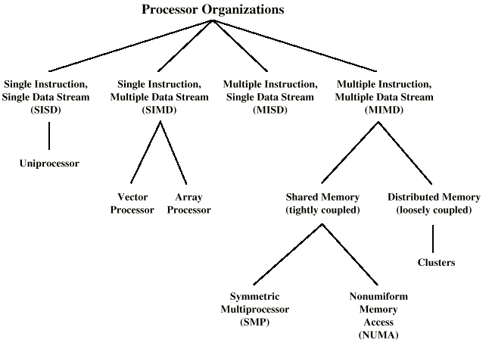
Taxonomy of Parallel Processor Architectures (Flynn)

Slide 8
MIMD - Overview
General purpose processors
Each can process all instructions necessary
Further classified by method of processor communication

Slide 9
Tightly Coupled - SMP
Processors share memory
Communicate via that shared memory
Symmetric Multiprocessor (SMP)
  Share single memory or pool
  Shared bus to access memory
  Memory access time to given area of memory is approximately the same for each processor

Slide 10
Tightly Coupled - NUMA
Non-Uniform Memory Access
Access times to different regions of memroy may differ

Slide 11
Loosely Coupled - Clusters
Collection of independent uni-processors or SMPs
Interconnected to form a cluster
Communication via fixed path or network connections (next week’s topic!)

Slide 12
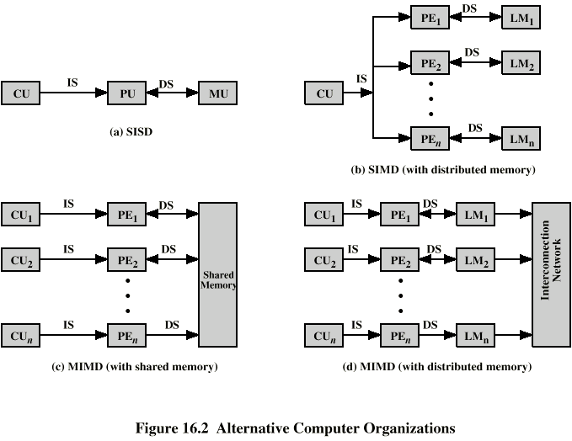
Parallel Organizations - SISD

Slide 13
Parallel Organizations - SIMD

Slide 14
Parallel Organizations - MIMD Shared Memory
QUESTION
What about cache
Consistency?

Slide 15
Parallel Organizations - MIMD
Distributed Memory

Slide 16
Symmetric Multiprocessors
A stand alone computer with the following characteristics
  Two or more similar processors of comparable capacity
  Processors share same memory and I/O
  Processors are connected by a bus or other internal connection
  Memory access time is approximately the same for each processor
  All processors share access to I/O
    Either through same channels or different channels giving paths to same devices
  All processors can perform the same functions (hence symmetric)
  System controlled by integrated operating system
    providing interaction between processors
    Interaction at job, task, file and data element levels

Slide 17
SMP Advantages
Performance
  If some work can be done in parallel
Availability
  Since all processors can perform the same functions, failure of a single processor does not halt the system
Incremental growth
  User can enhance performance by adding additional processors
Scaling
  Vendors can offer range of products based on number of processors

Slide 18
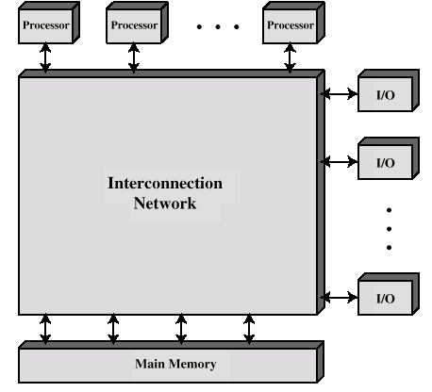
Block Diagram of Tightly Coupled Multiprocessor

Slide 19
Organization Classification
Time shared or common bus
Multi-port memory
Central control unit

Slide 20
Time Shared Bus
Simplest form
Structure and interface similar to single processor system
Following features provided
  Addressing - distinguish modules on bus
  Arbitration - any module can be temporary master
  Time sharing - if one module has the bus, others must wait and may have to suspend
Now have multiple processors as well as multiple I/O modules

Slide 21
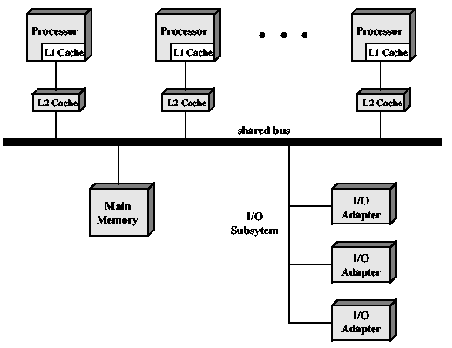
Shared Bus
Performance
Implications?

Slide 22
Time Share Bus - Advantages
Simplicity
Flexibility
Reliability

Slide 23
Time Share Bus - Disadvantage
Performance limited by bus cycle time
Each processor should have local cache
  Reduce number of bus accesses
Leads to problems with cache coherence
  Solved in hardware - see later

Slide 24
Multiport Memory
Direct independent access of memory modules by each processor
Logic required to resolve conflicts
Little or no modification to processors or modules required

Slide 25
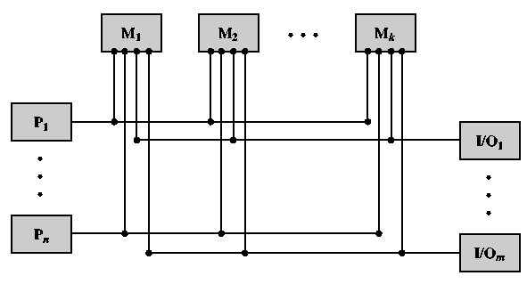
Multiport Memory Diagram

Slide 26
Multiport Memory - Advantages and Disadvantages
More complex
  Extra logic in memory system
Better performance
  Each processor has dedicated path to each module
Can configure portions of memory as private to one or more processors
  Increased security (against what?)
Write through cache policy

Slide 27
Central Control Unit
Funnels separate data streams between independent modules
Can buffer requests
Performs arbitration and timing
Pass status and control
Perform cache update alerting
Interfaces to modules remain the same
e.g. IBM S/370 family

Slide 28
Operating System Issues
Simultaneous concurrent processes
Scheduling
Synchronization
Memory management
Reliability and fault tolerance

Slide 29
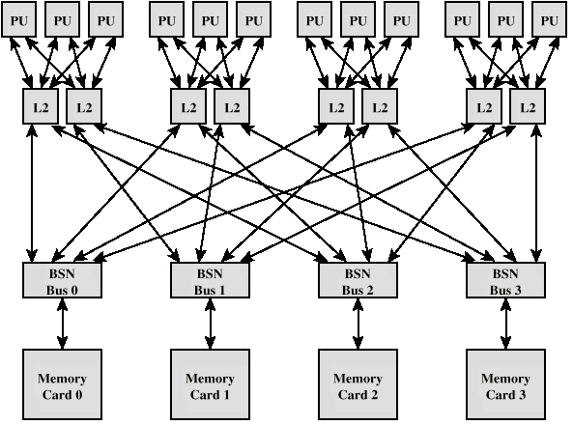
IBM S/390 Mainframe SMP

Slide 30
S/390 - Key components
Processor unit (PU)
  CISC microprocessor
  Frequently used instructions hard wired
  64k L1 unified cache with 1 cycle access time
L2 cache
  384k
Bus switching network adapter (BSN)
  Includes 2M of L3 cache
Memory card
  8G per card

Slide 31
Cache Coherence and
MESI Protocol
Problem - multiple copies of same data in different caches
Can result in an inconsistent view of memory
Write back policy can lead to inconsistency
Write through can also give problems unless caches monitor memory traffic

Slide 32
Software Solutions
Compiler and operating system deal with problem
Overhead transferred to compile time
Design complexity transferred from hardware to software
However, software tends to make conservative decisions
  Inefficient cache utilization
Analyze code to determine safe periods for caching shared variables

Slide 33
Hardware Solution
Cache coherence protocols
Dynamic recognition of potential problems
Run time
More efficient use of cache
Transparent to programmer
Directory protocols
Snoopy protocols

Slide 34
Directory Protocols
Collect and maintain information about copies of data in cache
Directory stored in main memory
Requests are checked against directory
Appropriate transfers are performed
Creates central bottleneck
Effective in large scale systems with complex interconnection schemes

Slide 35
Snoopy Protocols
Distribute cache coherence responsibility among cache controllers
Cache recognizes that a line is shared
Updates announced to other caches
Suited to bus based multiprocessor
Increases bus traffic

Slide 36
Write Invalidate
Multiple readers, one writer
When a write is required, all other caches of the line are invalidated
Writing processor then has exclusive (cheap) access until line required by another processor
Used in Pentium II and PowerPC systems
State of every line is marked as modified, exclusive, shared or invalid
MESI

Slide 37
Write Update
Multiple readers and writers
Updated word is distributed to all other processors
Some systems use an adaptive mixture of both solutions

Slide 38
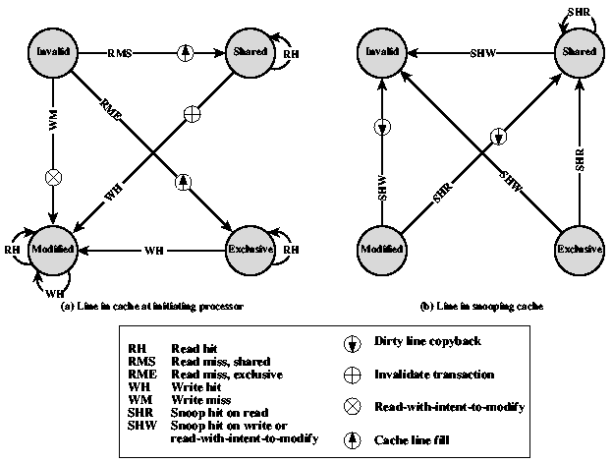
MESI State Transition Diagram

Slide 39
Clusters
Alternative to SMP
High performance
High availability
Server applications – very popular in scientific computing (see “Beowulf cluster”, you Linux folks ☺)
A group of interconnected whole computers
Working together as unified resource
Illusion of being one machine
Each computer called a node

Slide 40
Cluster Benefits
Absolute scalability
Incremental scalability
High availability
Superior price/performance

Slide 41
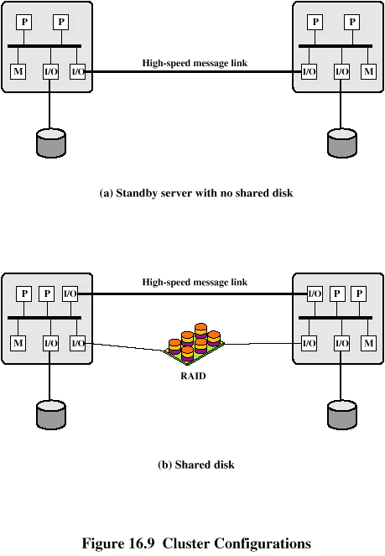
Cluster Configurations - Standby Server, No Shared Disk

Slide 42
Cluster Configurations -
Shared Disk

Slide 43
Operating Systems Design Issues
Failure Management
  High availability
  Fault tolerant
  Failover
    Switching applications & data from failed system to alternative within cluster
  Failback
    Restoration of applications and data to original system
    After problem is fixed
Load balancing
  Incremental scalability
  Automatically include new computers in scheduling
  Middleware needs to recognise that processes may switch between machines

Slide 44
Parallelizing
Single application executing in parallel on a number of machines in cluster
  Complier
    Determines at compile time which parts can be executed in parallel
    Split off for different computers
  Application
    Application written from scratch to be parallel
    Message passing to move data between nodes
    Hard to program
    Best end result
  Parametric computing
    If a problem is repeated execution of algorithm on different sets of data
    e.g. simulation using different scenarios
    Needs effective tools to organize and run

Slide 45
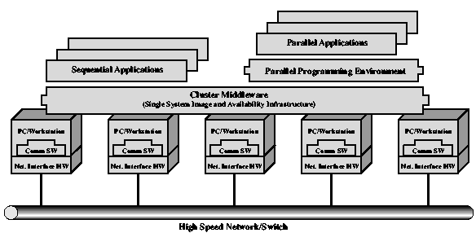
Cluster Computer Architecture

Slide 46
Cluster Middleware
Unified image to user
  Single system image
Single point of entry
Single file hierarchy
Single control point
Single virtual networking
Single memory space
Single job management system
Single user interface
Single I/O space
Single process space
Checkpointing
Process migration

Slide 47
Cluster v. SMP
Both provide multiprocessor support to high demand applications.
Both available commercially
  SMP for longer
SMP:
  Easier to manage and control
  Closer to single processor systems
    Scheduling is main difference
    Less physical space
    Lower power consumption
Clustering:
  Superior incremental & absolute scalability
  Superior availability
    Redundancy

Slide 48
Nonuniform Memory Access (NUMA)
Alternative to SMP & clustering (Sequent/IBM)
Uniform memory access
  All processors have access to all parts of memory
    Using load & store
  Access time to all regions of memory is the same
  Access time to memory for different processors same
  As used by SMP
Nonuniform memory access
  All processors have access to all parts of memory
    Using load & store
  Access time of processor differs depending on region of memory
  Different processors access different regions of memory at different speeds
Cache coherent NUMA
  Cache coherence is maintained among the caches of the various processors
  Significantly different from SMP and clusters

Slide 49
Motivation
SMP has practical limit to number of processors
  Bus traffic limits to between 16 and 64 processors
In clusters each node has own memory
  Apps do not see large global memory
  Coherence maintained by software not hardware
NUMA retains SMP flavour while giving large scale multiprocessing
  e.g. Silicon Graphics Origin NUMA 1024 MIPS R10000 processors
Objective is to maintain transparent system wide memory while permitting multiprocessor nodes, each with own bus or internal interconnection system

Slide 50
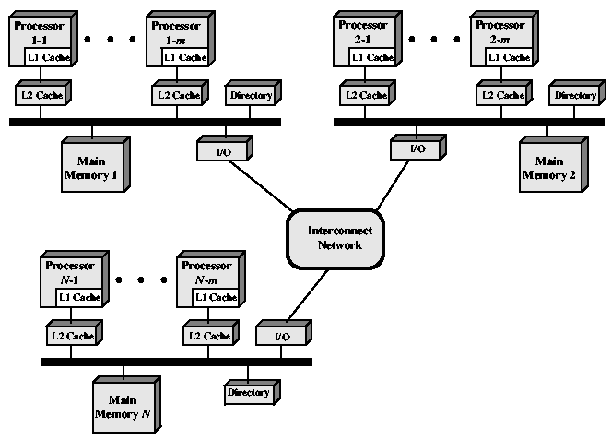
CC-NUMA Organization

Slide 51
CC-NUMA Operation
Each processor has own L1 and L2 cache
Each node has own main memory
Nodes connected by some networking facility
Each processor sees single addressable memory space
Memory request order:
  L1 cache (local to processor)
  L2 cache (local to processor)
  Main memory (local to node)
  Remote memory
    Delivered to requesting (local to processor) cache
Automatic and transparent

Slide 52
Memory Access Sequence
Each node maintains directory of location of portions of memory and cache status
e.g. node 2 processor 3 (P2-3) requests location 798 which is in memory of node 1
  P2-3 issues read request on snoopy bus of node 2
  Directory on node 2 recognises location is on node 1
  Node 2 directory requests node 1’s directory
  Node 1 directory requests contents of 798
  Node 1 memory puts data on (node 1 local) bus
  Node 1 directory gets data from (node 1 local) bus
  Data transferred to node 2’s directory
  Node 2 directory puts data on (node 2 local) bus
  Data picked up, put in P2-3’s cache and delivered to processor

Slide 53
Cache Coherence
Node 1 directory keeps note that node 2 has copy of data
If data modified in cache, this is broadcast to other nodes
Local directories monitor and purge local cache if necessary
Local directory monitors changes to local data in remote caches and marks memory invalid until writeback
Local directory forces writeback if memory location requested by another processor

Slide 54
NUMA Pros & Cons
Effective performance at higher levels of parallelism than SMP
No major software changes
Performance can breakdown if too much access to remote memory
  Can be avoided by:
    L1 & L2 cache design reducing all memory access
      Need good temporal locality of software
    Good spatial locality of software
    Virtual memory management moving pages to nodes that are using them most
Not transparent
  Page allocation, process allocation and load balancing changes needed
Availability?

Slide 55
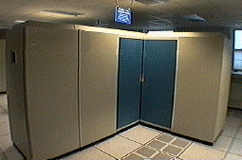
Vector Computation
Maths problems involving physical processes present different difficulties for computation
  Aerodynamics, seismology, meteorology
  Continuous field simulation
High precision
Repeated floating point calculations on large arrays of numbers
Supercomputers handle these types of problem
  Hundreds of millions of flops
  $10-15 million
  Optimised for calculation rather than multitasking and I/O
  Limited market
    Research, government agencies, meteorology
Array processor
  Alternative to supercomputer
  Configured as peripherals to mainframe & mini
  Just run vector portion of problems

Slide 56
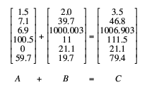
Vector Addition Example

Slide 57
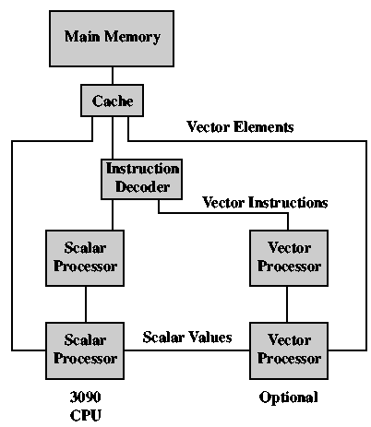
IBM 3090 with Vector Facility

Slide 58
Approaches
Why is JOINing
An issue?
(pipelines?)
General purpose computers rely on iteration to do vector calculations
In example this needs six calculations
Vector processing
  Assume possible to operate on one-dimensional vector of data
  All elements in a particular row can be calculated in parallel
Parallel processing
  Independent processors functioning in parallel
  Use FORK N to start individual process at location N
  JOIN N causes N independent processes to join and merge following JOIN
    O/S Co-ordinates JOINs
    Execution is blocked until all N processes have reached JOIN

Slide 59
Processor Designs
Pipelined ALU
  Within operations
  Across operations
Parallel ALUs
Parallel processors

Slide 60
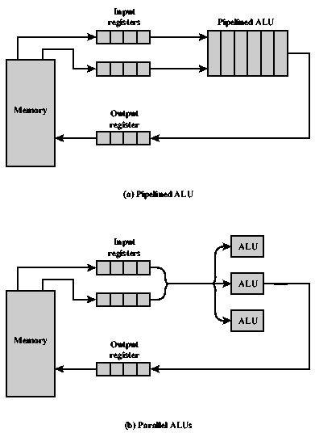
Approaches to Vector Computation

Slide 61
Chaining
Cray Supercomputers
Vector operation may start as soon as first element of operand vector available and functional unit is free
Result from one functional unit is fed immediately into another
If vector registers used, intermediate results do not have to be stored in memory

